Slide 1

CSE 583
Software Design for Data Scientists Course Introduction & validating software
David Beck^{1,2,3,4}, Bryna Hazelton^{1,5},
Natalie Robbins⁶, Nels Schimek²
¹eScience Institute
²Chemical Engineering
³Computer Science
⁴Environmental & Occupational Health Sciences
⁵Physics
⁶Linguistics
University of Washington
October 3, 2024

Slide 2
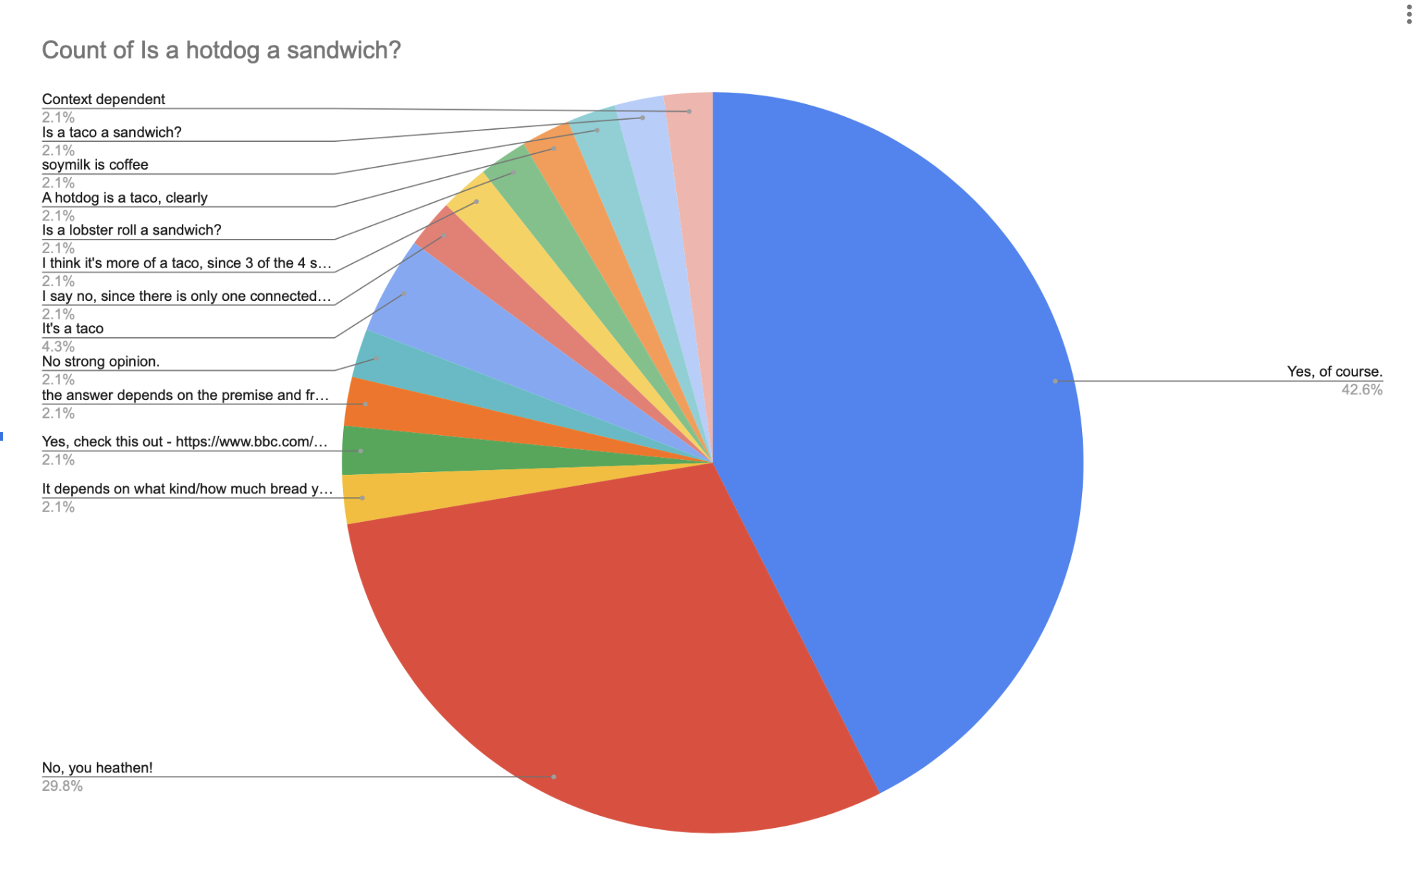
Make sure you have a GitHub account and fill out the survey to link it to you netid

Slide 3
Review from Tuesday
What do the following commands do?
ls
mkdir
cp
rm
touch
cat
rmdir
cat
more / less
curl

Slide 4
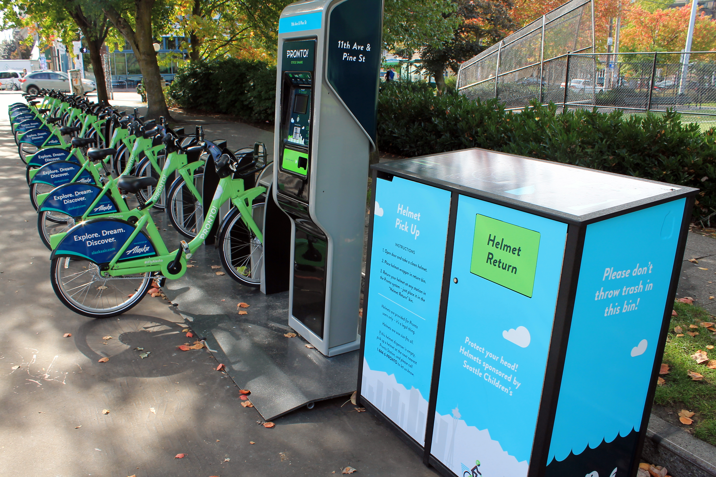
Pronto Data

Slide 5
Pronto Data
Used to be available from Seattle’s open data portal, but it was finally taken down.
So we will access it from an AWS bucket where it’s been conveniently stored for us:
https://s3.amazonaws.com/pronto-data/open_data_year_one.zip

Slide 6
Getting Data With Shell Scripts

Slide 7
Demo
Create the project directory structure and README
Get the pronto data from the Internet, https://s3.amazonaws.com/pronto-data/open_data_year_one.zip
Unpack the data
Comma separated variable (CSV) files
Automate the workflow using a shell script

Slide 8
Useful Shell Commands
Command | Task | Example usage
ls | List files | ls
cp | Copy files | cp original_file new_file
mv | Move / rename files | mv original_file new_file
rm | Remove / delete files | rm original_file
cd | Change directory | cd some_directory
pwd | Print working / current directory | pwd
mkdir | Create directory | mkdir some_directory
rmdir | Remove / delete directory | rmdir some_directory
cat | View files | cat some_file
head | View begining of file | head some_file
tail | View end of file | tail some_file
grep | Search file for matching lines | grep search.text some_file
sort | Sort lines | sort some_file
uniq | Print unique lines | uniq some_file
diff | Compare to files | diff original_file new_file
unzip | Uncompress a file | unzip compressed_file.zip
curl | Download a file using its URL | curl some URL
Also see http://www.pixelbeat.org/cmdline.html
Also search shell + <cmd name>

Slide 9
Version Control

Slide 10
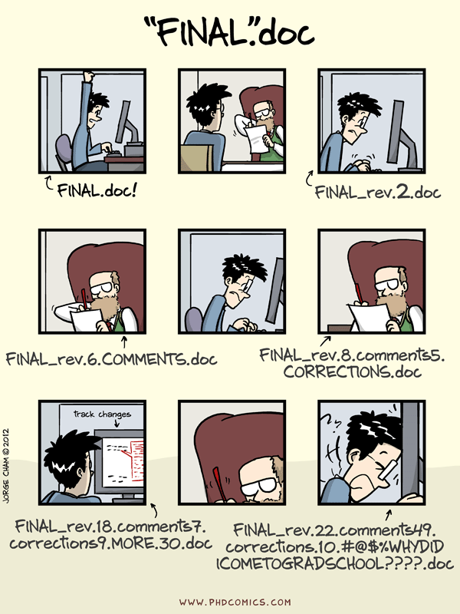

Slide 11
Quick Survey: Raise your hand if...
You’ve never used source / version control
You’ve used source control, but not git
Beginner in git as an individual (git add, git commit)
Moderate/Advanced in git as an individual (git rebase)
Beginner in git as collaborative team (git push, git pull)
Moderate/Advanced in Git/GitHub as collaborative team (pull requests, hooks)

Slide 12
git and GitHub
git
version control
local + remote
GitHub
Tools for collaboration
Issue tracking, pull requests with code review, forking
hosting & public access
Notes:
Delineate git vs GitHub: version control vs collaborative tools

Slide 13
Why version control (and git)
simplicity
only need one copy
always clear what the current version is
git just tracks changes
backup!
freedom to delete code
git keeps the full history, you can always resurrect old code
don’t need to keep commented code around ‘just in case’
provenance and reproducibility
makes it possible to track exactly what code was run for any analysis
fine-grained history
good support for branching and merging
supports development separate from a stable ‘main’ branch
aids parallel development
Notes:
git repos save the full history, but only the “deltas” — lightweight compared to multiple full copies
preserves full, fine-grained history (depending on user behavior) — not just copies of major revisions
with a little work (to capture the git information when code is run) you can always know exactly what code was run for any analysis
branching & merging: makes it easy to develop new features off the main stable branch and merge them in when ready, supports parallel development

Slide 14
GitHub collaboration tools
Issue tracking
with labelling, assignments and links between issues and PRs
Pull Requests (PRs)
build code reviews into the process of merging in new functionality
integrations with other services
Continuous integration: tests and other checks run every time the repo is updated
Documentation hosting: rebuild the documentation every time the repo is updated
user interface for exploring code changes
graphical diffs between any commits or branches
Notes:
Issue tracking: including labels, assignments, links between issues & PRs
Pull Request: process for merging changes into the main branch of repository, builds in code review

Slide 15
Reproducibility & Open Scholarship Hierarchy
public code
complementary (some times required) to publishing
documentation and readability are key
the analysis is the code — allows others to see what you did
open source code
requires an open source license
API documentation
unit testing and continuous integration
building a user community
reproducibility
capture of versions & settings
open data
full stack capture, containers (docker)
Notes:
public vs open source
No license means no one can use your code (or even write new code based on your code)
spectrum of reproducibility

Slide 16
git basics
local repository
a complete copy (with the full history) on your local machine
self-contained and self-sufficient
remote repository
a complete copy hosted remotely (e.g. on GitHub) — the repository all collaborators have access to
snapshots (commits)
the unit of tracking within git — can be multiple changes to multiple files
should be used to identify ‘atomic’ changes — things that go together
commit early & often — fine-grained commits make the history more useful

Slide 17
Working directory
staging area (index)
local repository:
snapshots
remote repository:
snapshots
Notes:
talk through the working directory and staging (briefly)

Slide 18
git add
git commit
Working directory
staging area (index)
local repository:
snapshots
remote repository:
snapshots
git status: use frequently to understand where files & code changes are in this process
Notes:
talk through the way git fundamentally thinks
purpose of the staging area is to make it possible to only commit some of the local changes

Slide 19
git add
git commit
git push
Working directory
staging area (index)
local repository:
snapshots
remote repository:
snapshots
git merge
git fetch
git pull
git status: use frequently to understand where files & code changes are in this process

Slide 20
git user interfaces
command line
available everywhere including remote servers
can be hard to visualize the process
gui (GitKraken, SourceTree, Lazygit — terminal gui, GitLens in VSCode)
good for visualizing the process
great interface for viewing history and diffs
encourages some good practices (viewing changes before adding)
easy to do powerful things (add parts of files, deal with merge conflicts, undo)
GitHub
great interface for viewing history and diffs, but restricted to what’s on the remote
required for issue tracking and pull request management

Slide 21
Resources
git parable (conceptually building up why git is the way it is): https://tom.preston-werner.com/2009/05/19/the-git-parable.html
Software Carpentry hands-on tutorial: http://swcarpentry.github.io/git-novice/
Lab-style git intro: https://github.com/HERA-Team/CHAMP_Bootcamp/blob/master/Lesson2_IntroToComputing/git-lab-handout.pdf
eScience office hours (https://escience.washington.edu/office-hours/#eScienceDataScientists)

Slide 22
Hands on practice

Slide 23
git config
Global settings for git
name and email address (to identify who made changes) — should match email associated with your GitHub account
preferred text editor (for commit messages)
To see current settings:
git config —list
To change these settings:
git config --global user.name "Vlad Dracula"
git config --global user.email "vlad@tran.sylvan.ia"
git config --global core.editor "nano -w”

Slide 24
Making a new repository
On GitHub
choose public or private
initialize with a readme
choose a .gitignore (also see https://github.com/github/gitignore for more language options, including matlab)
choose a license
Clone the repository locally
ssh vs https
git clone <repo-address>
git remote -v to see the address of the remote
Notes:
show the process

Slide 25
making changes
Check the status
use git status to see what things have changed
use this command liberally — it’s always safe and helps you know what’s going on
Identify all the changes you want to snapshot together
use git diff to see what the changes are
use git add <file> to move changes to the staging area
only include changes that go together
make the snapshot
use git commit to make the snapshot: brings up a browser to add a commit message
or git commit -m ‘your message here’
commit messages should be descriptive
view the history
git log, git show
Notes:
talk through the way git fundamentally thinks
purpose of the staging area is to make it possible to only commit some of the local changes

Slide 26
syncing with the remote
get snapshots from the remote
use git fetch to get the snapshots but not apply them to the local repo
use git status to see differences between the local and remote
use git merge to apply the snapshots to the local repo
git pull is git fetch immediately followed by git merge but doesn’t let you examine the snapshots before applying them
send your snapshots to the remote
use git push to send your local snapshots to the remote
git will not let you push if there are snapshots on the remote that you have not yet merged into your local repository
view the history
git log, git show
Notes:
in order to push, you have to have all the remote changes

Slide 27
branching
create a new branch and switch to it
use git checkout -b <branch_name> to create the branch and switch to it
for existing branches, use git checkout <branch_name> to switch to that branch
make changes and snapshots on that branch
push the branch up to the remote
use git push --set-upstream origin <branch_name> to make a branch on the remote that tracks your new local branch
make more changes and snapshots and push/pull
to merge the branch into the main, make a pull request
leads to a code review

Slide 28
merging vs rebasing branches
merging in branches is straightforward, but can result in a somewhat complicated graph
rebasing is an alternative approach that results in a neat, linear graph at the expense of rewriting history
rebasing effectively moves the location that a branch leaves the tree
can be used to place branches at the tip of the master branch to avoid having to merge
effectively replays the changes in the branch after the end of the master branch

Slide 29
Collaborating with GitHub

Slide 30
Collaborative coding and data analysis
Issues and discussions
Keep track of TODOs and worries
Use labels!
Communicating with collaborators, including non-coding ones (advisors)
Threaded logbook linked to code (e.g. https://github.com/EoRImaging/FHD/issues/39)
Can embed plots, images as appropriate
Notes:
show FHD discussion

Slide 31
Collaborating on code
Branching workflow
make a branch for a specific topic
you can have multiple branches!
Pull Requests for code reviews (e.g. https://github.com/RadioAstronomySoftwareGroup/pyuvdata/pull/1292)
linking to issues
GitHub Milestones/Projects
track sets of issues towards a larger goal
Notes:
continuous integration
templating
changelog

